Slide 1
Exercise, ADHD & Dopamine
Behaviorist & Cognitivist
Mental Models
Timothy Kieran O’Mahony, PhD, FRGS

Slide 2
Your Challenge
What is the connection between ADHD and Working Memory
Take a minute and write your Initial Thoughts about ADHD and Working Memory
Initial Thoughts

Slide 3
Two Lenses …
ADHD Exercise
Dopamine Working Memory
Tell us about one thing you do everyday to include physical exercise in your teaching
Tell us about one thing you do everyday to help grow your students’ working memory

Slide 4
Making Models Visible…
Behaviorist Approach: Where’s the Dopamine?

Slide 5
Cognitivist Approach
Build Neural Circuits
Functional Connectivity is built on Structural Connectivity
Longitudinal study (N= 500) 3 – 23 years (Dana, 2017)
Individual success at reasoning – Executive Function
White matter tracts between parietal lobe and PFC
If we begin with younger children – improved reasoning continues for life
Conclusion: Important in childhood to lay down strong neural circuitry to build Executive Function capacity
http://www.dana.org/News/ Structural_Connectivity_Sets_the_Stage_for_Later_Reasoning_Ability/
Notes:
Inferior Parietal Lobe needs to be connected to the prefrontal Cortex
500 participants tested over longitudinal studies 3 – 23 years old
strong structural connections, or white matter tracts, between the inferior parietal lobe and the rostrolateral PFC in younger children were associated with both strong functional connectivity and improved reasoning in their young adult years.
Important in childhood to lay down those strong cables to build up those abilities.
http://www.dana.org/News/Structural_Connectivity_Sets_the_Stage_for_Later_Reasoning_Ability/

Slide 7
3D Neuron (AIBS 2017)

Slide 8
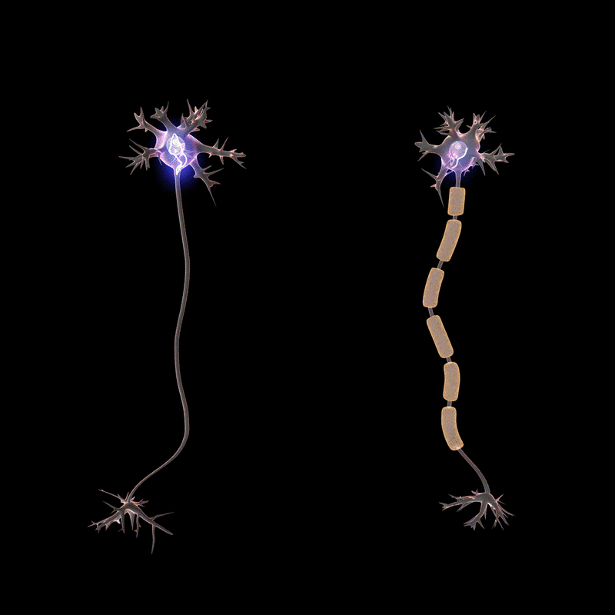
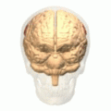
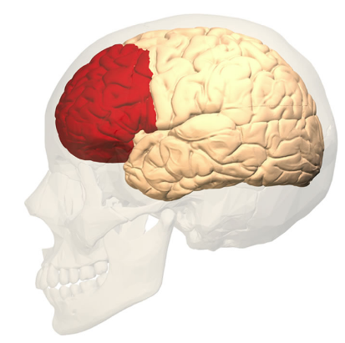
Inferior Parietal Lobe -> PFC
Notes:
Inferior Parietal Lobe needs to be connected to the prefrontal Cortex
500 participants tested over longitudinal studies 3 – 23 years old
strong structural connections, or white matter tracts, between the inferior parietal lobe and the rostrolateral PFC in younger children were associated with both strong functional connectivity and improved reasoning in their young adult years.
Important in childhood to lay down those strong cables to build up those abilities.

Slide 9
Implications of Plasticity
Intentional practice causes the birth of new neurons in a key structure in the brain important for memory - hippocampal neurogenesis
Clear structural changes in the brain
Thicker outer cortex
Neurotransmitter level increased (especially the neurotransmitter for memory - acetocholine)
More synapses – the connections between the neurons
BDNF – miracle grow for the brain - Exercise
Notes:
(brain is the number one consumer of oxygen in the body - want as much blood vessels as possible to nourish with good oxygenated blood)

